Slide 1
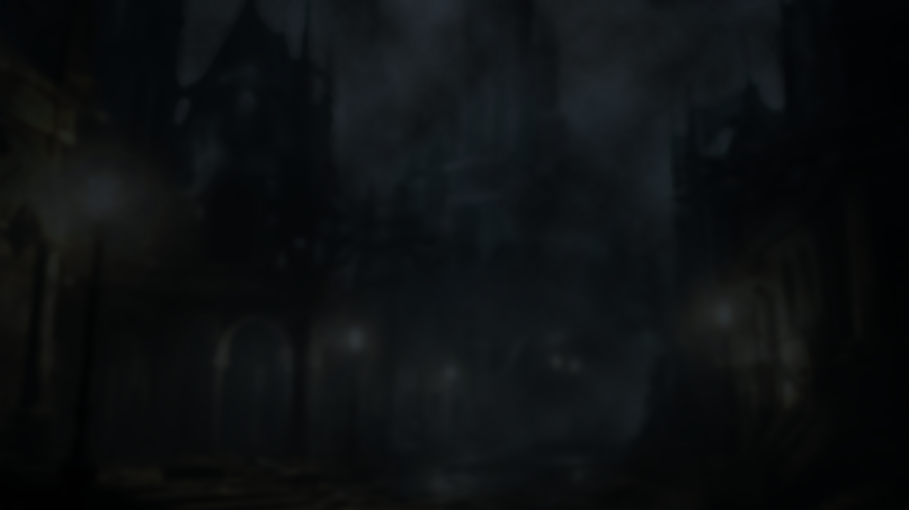
Divergence
Group Project Pitch
Presented by Mikail Kahya & Finian Horrie
Notes:
Greetings
Game name: Divergence
Group project proposal/pitch
Presented by Mikail and Finian
Team consists of 3 members

Slide 2
Game Idea
First Person round-based survival
Human Monsterization
Limb replacement
Abilities and weapons
Dynamic map
Notes:
First person round based survival game
All enemies were once human
Shiflix
Godlike entity, allowing conscious
Replace limbs with enemy parts
Can replace limbs with ones gathered from opponents
Give access to new abilities and weapons
Dynamic map
Map walls can be torn down by boss monsters, allowing map size increase

Slide 3
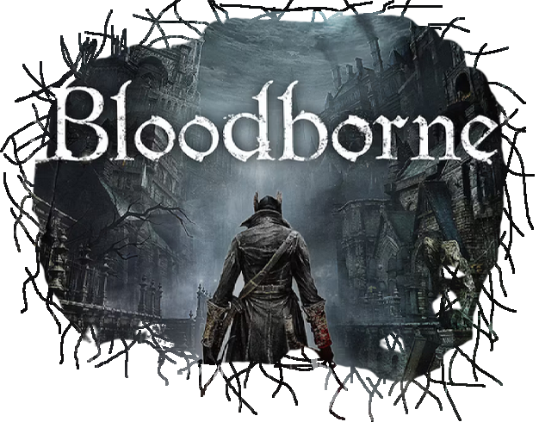
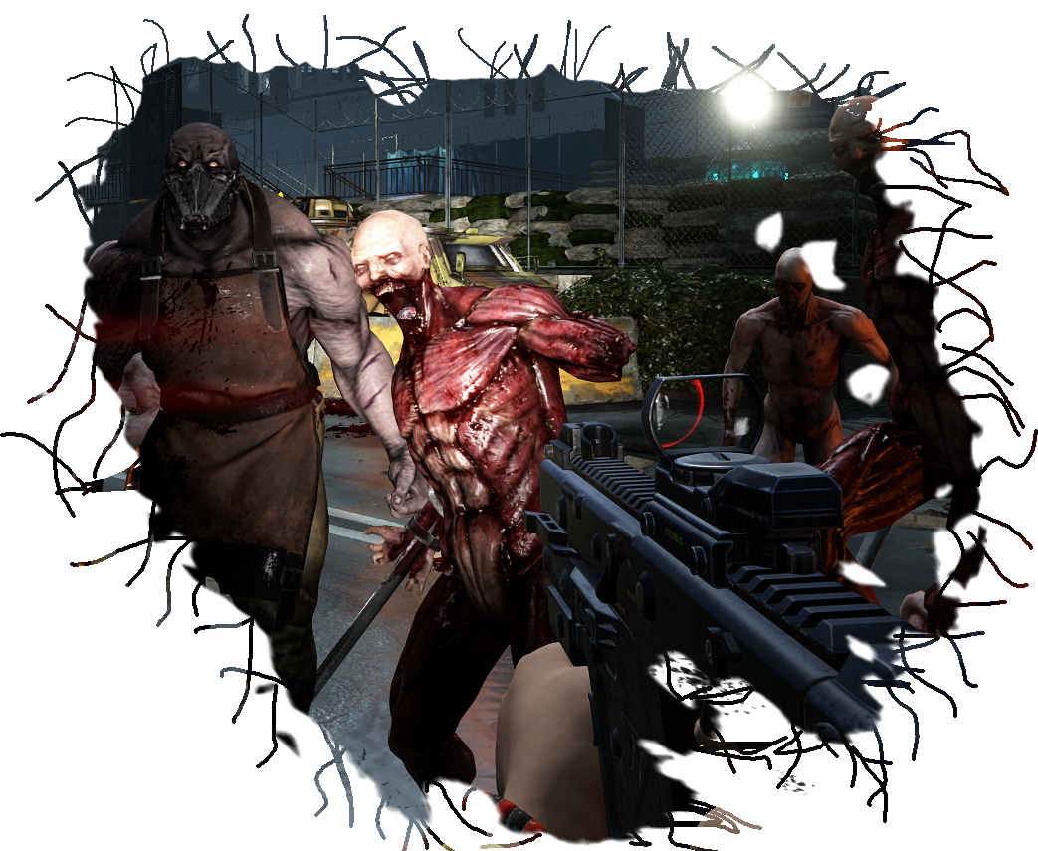
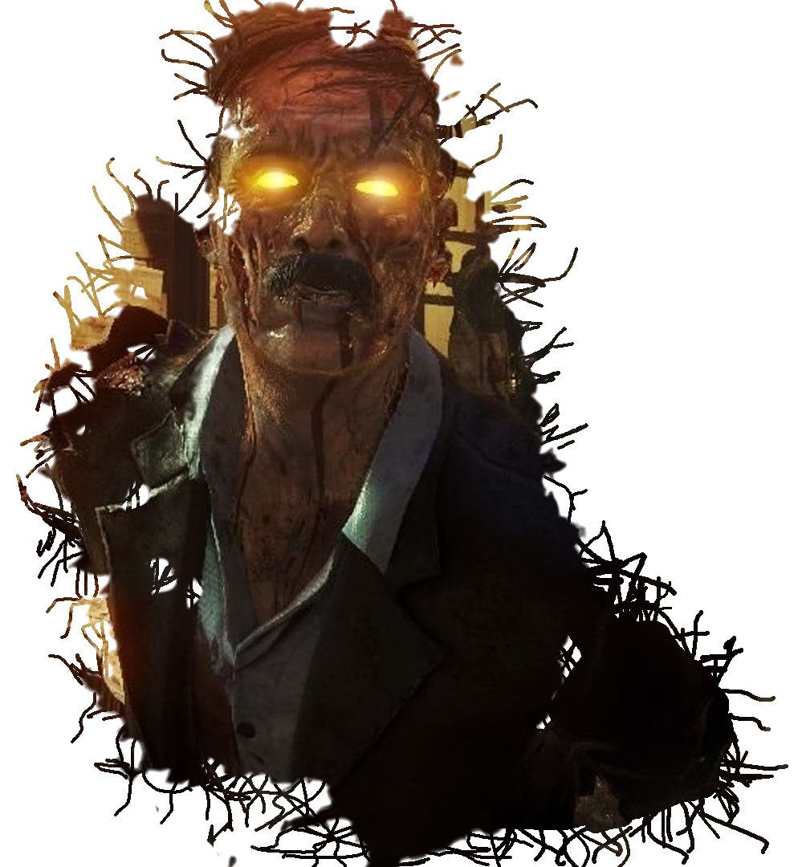
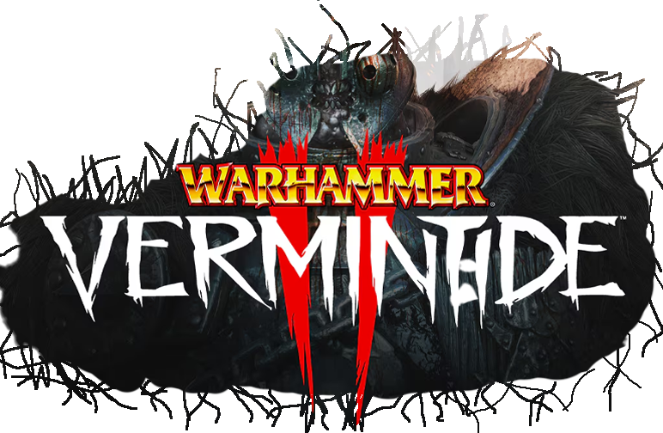
Inspiration
Notes:
Game Inspiration
Call Of Duty Zombies
Round based system
Altered humans
Killing Floor
Same points as COD
Upgrade station between rounds
Class specialization and upgrading
Warhammer Vermintide
Special Units
Hordes of enemies you can defeat
Bloodborne
Mostly mood
Victorian

Slide 4
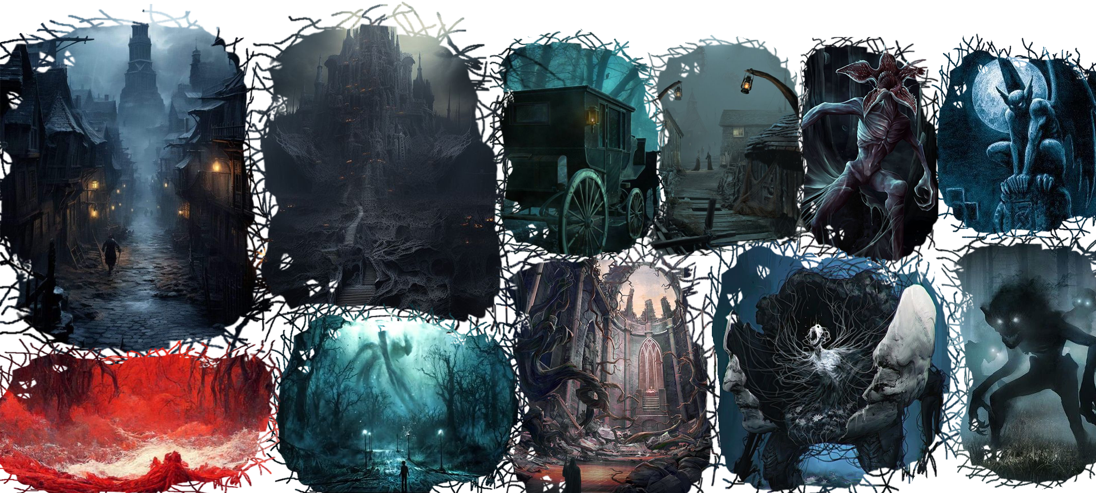
Mood
Notes:
Mood
Dark, eerie
Should feel like an abandoned/haunted city
Dark vines and ivy should be omnipresent in the city
Enemies
Mutilated, modified human like monsters
Should instil an uneasy feeling into the player
Variety

Slide 5
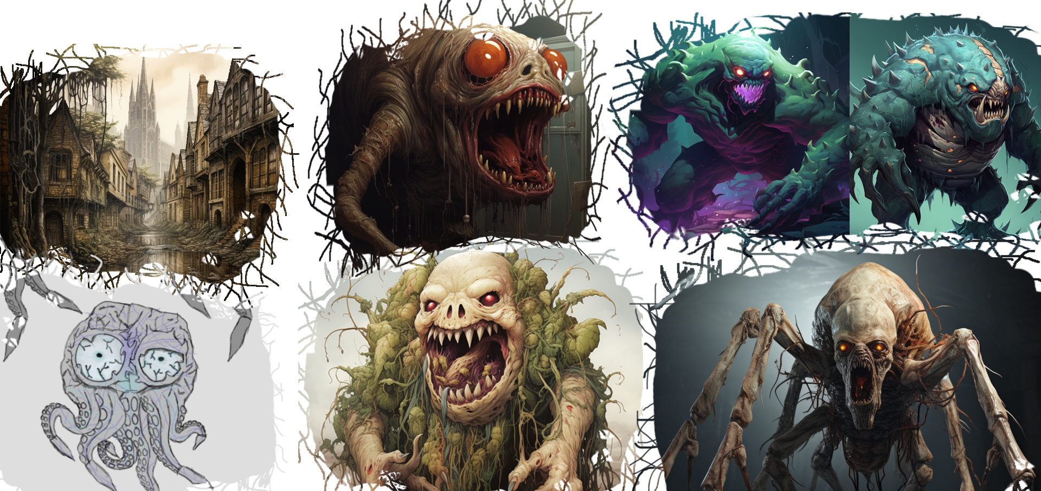
Concepts
Notes:
Concepts
Dark and Grown over Victorian town
Many enemy types
Mimic
Brute
Mind Controller
Biter
Spider, climb
Easily expand

Slide 6



Goals
Game we wanted
Learn UE
Store release
Contests
Notes:
Goals
What we are planning to make is a game that we wanted to see
We want more round-based games
Make one with our unique spin on the genre
Positive reception from previous pitches
Learn Unreal Engine
Capabilities
Increase our own skill in engine
After the project is finished, we want to have a game store release
Hand in our project to various game competitions like GDWC student game and the Belgian game awards
I hope you are excited to see divergence as much as us
Thank you for attention

